Slide 1


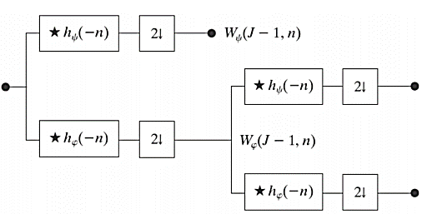
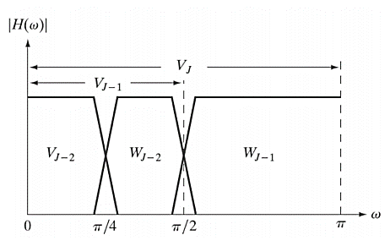
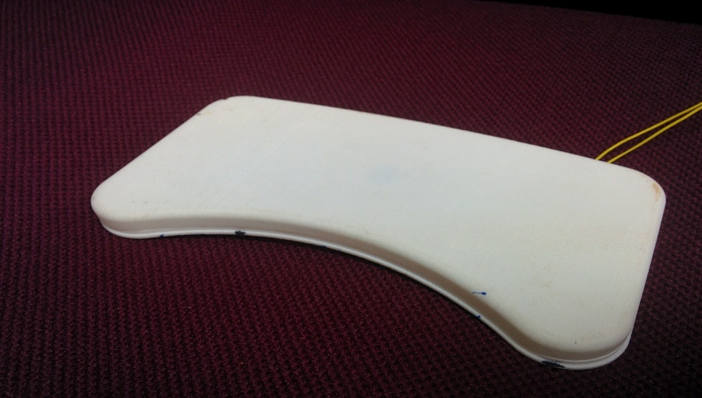
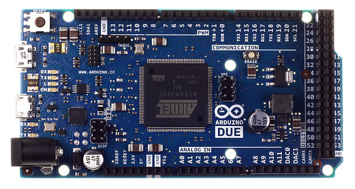
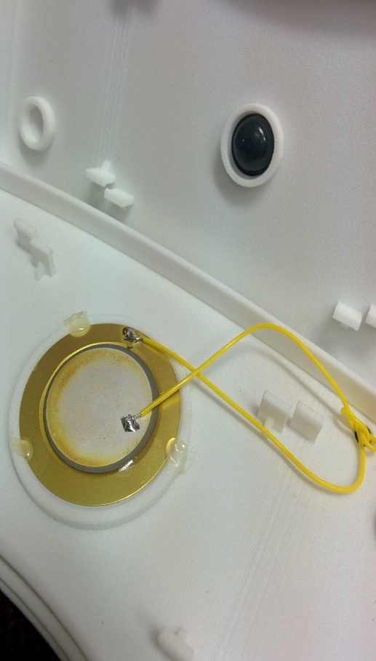
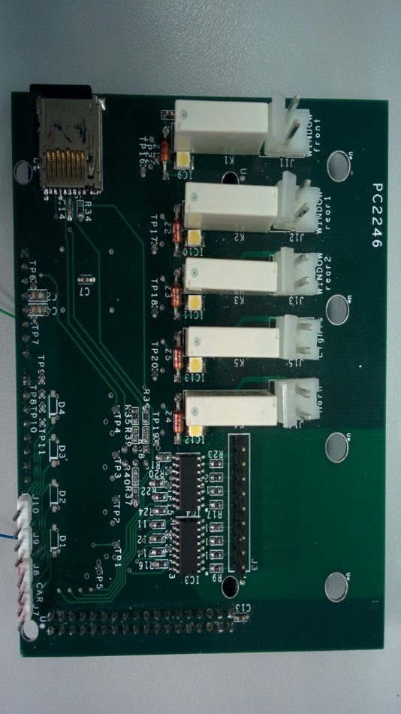
Andrew and Erna Viterbi
Faculty of Electrical Engineering
Signal and Image Processing Lab
Machine Learning of a Piezoelectric Sensor for Detection of Children Abandoned in Cars
Li Adar and Tom Beer
Supervised by Alon Eilam and Yair Moshe
Motivation
Feature Extraction: Wavelet Transform
Results
In recent years, more and more children are forgotten in cars by their parents or caregivers, with tragic results
This increasing phenomenon has even been given a name: ‘Forgotten Baby Syndrome” (FBS)
In Israel, 19 children have died in 400 such cases, in the last 8 years only
Awareness raising attempts have been found fruitless
A technological approach is essential to eradicate this problem
Develop a sensor based system for use in the car
Use statistical signal processing and machine learning techniques to detect and alarm in such cases
Achieve reliable performance and increase survival rates
We used features that are based on the discrete wavelet transform (DWT) of the signals
This transform allows for multiresolution analysis and captures both time and frequency information of the signals
With optimal parameters for the wavelet transform and KNN algorithm, we tested different delays of the median filter.
A filtering of 14 time frames (delay of 30 seconds) provided in error rates of less than 0.1%
Goals
Real Time Implementation
Wavelet transform, LDA classifier and median filter were implemented on Arduino microcontroller
Real-time computation measurements were made to make sure the 2 seconds time limit is held
Full compatibility with Matlab simulation was achieved
Hardware
Classification Algorithms
Arduino DUE microcontroller
Interface board (microcontroller to car and sensors)
Piezoelectric sensor in custom designed package
Many classification algorithms were tested, including LDA, KNN, SVM, logistic regression, decision trees and naïve Bayes.
After parameter tuning for each, KNN provided the optimal performance, by far.
Passenger Detection
We wanted to see if the poor false positive rates of common seat belt detectors can be improved
This seems a greater challenge, as signals from driving cars are more noisy
A new database was acquired: 4 hours of recordings from a driving car
Data acquisition
Median Filtering
All data was acquired by us in different scenarios, 10 hours total
Signals are sampled at 1K samples per second
Obtained recordings are pressure signals similar to ones used in ballistocardiography
Low error rates are critical for this task: misdetections may be fatal and false alarms reduce reliability
On the other hand, a delay of a few seconds is harmless
The idea is to use this delay to output filtered decisions with higher certainty
Here is an example of this block’s effect:
Using the same framework as the child detection scenario, error rates of 1% were achieved – a good starting point for future work
A signal of a kid
Summary
We developed a fully operational machine learning based system for the detection of children forgotten in cars.
Our work showed that child detection in cars can be done with error rates as low as 0.07% - that is one error every 1400 data samples, or a single error every hour.
A signal of a different kid

